Slide 1
Solute and Solvent

Slide 2
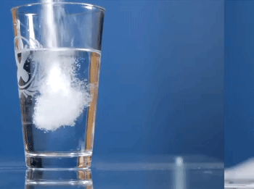
By the end of this lesson you should be able to:
1. | State the difference between "clear" and "colourless."
2. | Describe an example of a solvent.
3. | Describe an example of a solute.

Slide 3
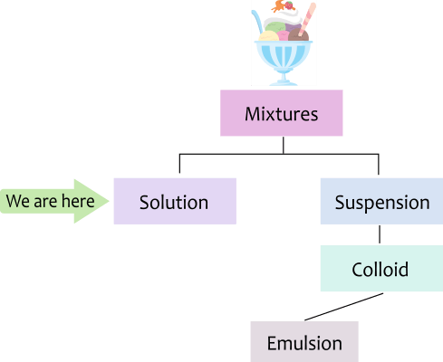
The first special type of mixture that we will learn about is a solution.
Solutions are a type of liquid mixture containing two or more parts.

Slide 4
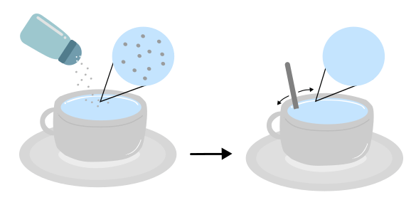
When you put salt into water, the grains of salt slowly disappear as you stir.
The salt is still in the water, but you can't see it anymore.
So where did it go?

Slide 5
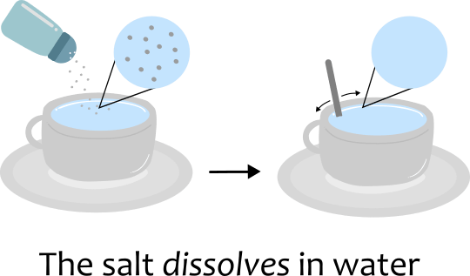
Salt is dissolving in the water.
Water breaks the salt crystals apart into salt particles, and these move around evenly in the water, free from other salt particles.
This creates a solution.

Slide 6
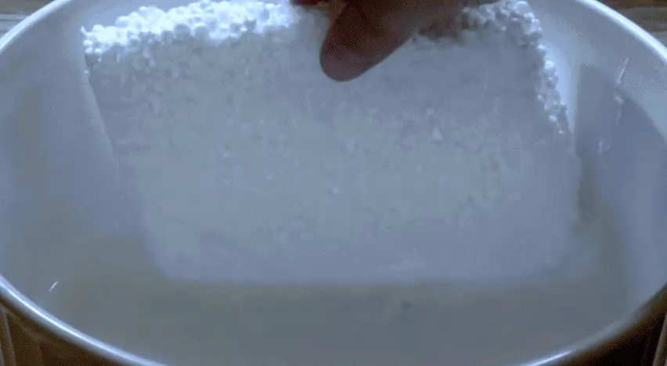
Solutions are a type of impure substance.
They are made when one substance dissolves in another substance.
The substance that dissolves is called a solute. The liquid it dissolves in is called a solvent.

Slide 7
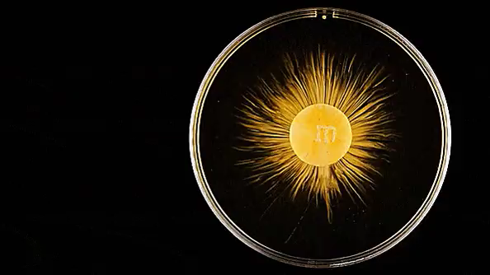
For example:
Here is a GIF of an M&M dissolving in water.
Water is the solvent, because the M&M is dissolving in it.
The M&M is the solute, because it is dissolving in water.

Slide 8
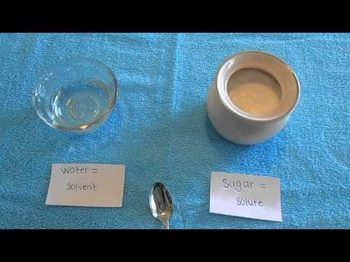

Slide 9
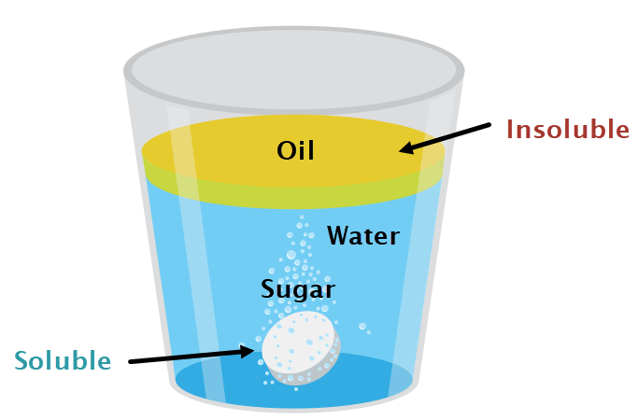
A solute that is able to dissolve in a particular solvent is said to be soluble in that solvent.
For example, sugar is soluble in water.
If a solute cannot dissolve in a particular solvent, then it is insoluble in that solvent. For example, oil is insoluble in water.

Slide 10
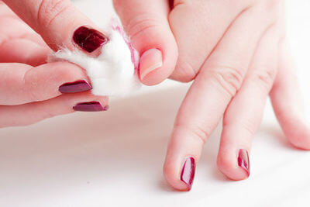
Water can dissolve most things, so it is called a "universal solvent."
Solvents like acetone and ethanol can be used to dissolve solutes that are insoluble in water.
For example, acetone is used as nail polish remover, because nail polish is soluble in acetone and not water.

Slide 11
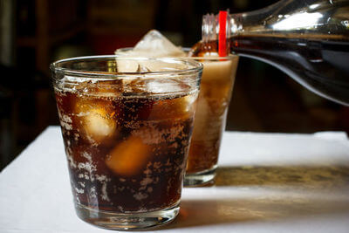
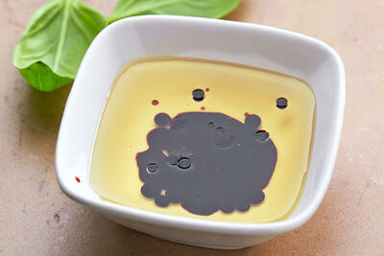
Solutions are not limited to solids dissolved in liquids.
Fizzy drinks are solutions of carbon dioxide gas dissolved into water; it is the carbon dioxide which makes the fizzy bubbles.
Vinegar is a solution of acetic acid, a liquid, which is dissolved in water.

Slide 12
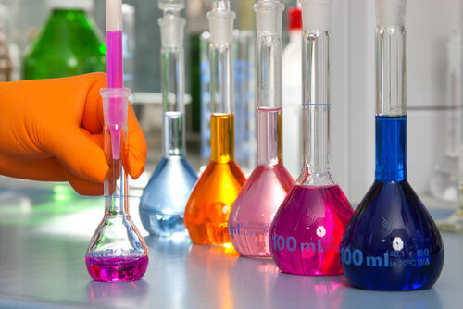
Solutes are able to be liquids, solids, or gases, while solvents are usually liquids.

Slide 13
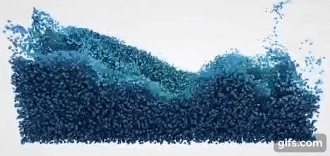
In a solution, solute particles are spread evenly throughout the solvent.
This is referred to as being "homogeneous".
What this means is that all parts of the solution are identical. If you separate part of the solution, both parts will have identical properties.

Slide 14
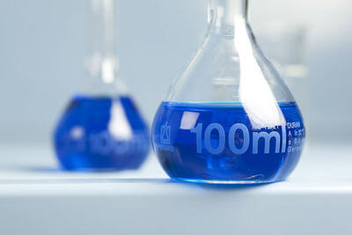
Solutions are always clear, meaning that you can see through them. However this is not the same as being uncoloured.
A blue solution will still be transparent, and we can see through it. If the solution has no colour, like water, we say that it is colourless.
So water is clear and colourless and the solution below is clear and coloured.

Slide 15
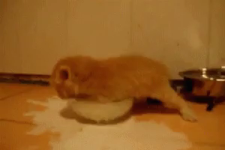
A liquid like milk is neither clear nor colourless. This is because milk is not a solution.
Milk is a type of liquid called an emulsion.

